Slide 1
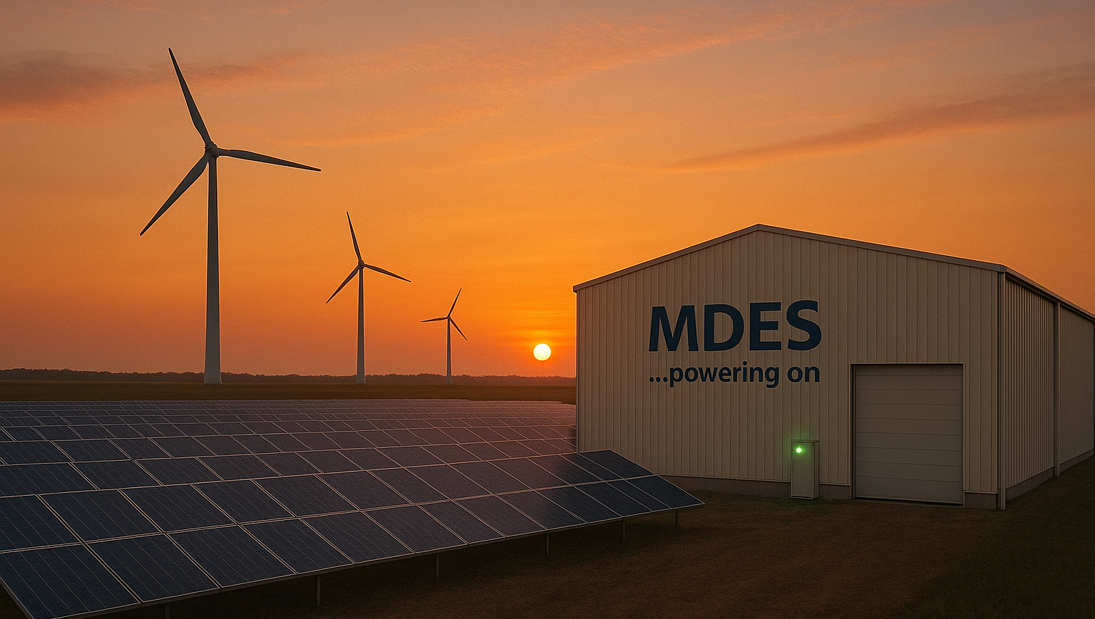




www.MDESAlliance.com
www.era.ac.uk
www.Nottingham.ac.uk
https://iea.es.org.
Medium-Duration Energy Storage:
Policy and Markets. Jan 19, 2026.
Welcome Prof. Seamus Garvey

Slide 2
Welcome – “housekeeping”
THIS ENTIRE MEETING IS BEING RECORDED.
If you do not wish to have something on record, ‘best not to say it!
Welcome – and some thanks & background!
Car Parking UoN Visitors need to park in Pay & Display car parks
Fire Safety No fire drills expected. Assemble beside bins. (20m N)
WiFi UoN Guest (no password, but 30 minutes only)
Slide #2

Slide 3
Event Structure: #1
10:00 S. Garvey Welcome and opening remarks.
10:10 S. Garvey MDES: An introduction to its importance and obstacles faced.
10:50 M. Howitt Challenges of intermittent renewables, storage and the grid
11:30 REFRESHMENTS BREAK
11:50 P. Smith EnergyDome’s MDES product and market perspectives
12:30 S. Mathez More observations on MDES & Switzerland’s Flexible Hydropower
13:00 LUNCH
Slide #3

Slide 4
Event Structure: #2
13:40 J. Loughhead If MDES technologies really could be helpful in reducing UK energy costs, then they will certainly get built (?)
14:05 Vincent Bonnin Energy Storage to complement marine energy in NL.
14:25 A. Somani The value of stored energy
14:55 REFRESHMENTS BREAK
15:15 Discussion and drawing out messages. 16:00 END
Original programme contained a talk also by Susanne Nies of Helmholz-Zentrum Berlin. ‘Confusion due to poor communication by me!!
Slide #4

Slide 5
Everybody can & should make input !
Obviously, the Chat function exists for raising questions or making short comment.
We will make time after each talk for Q&A. Please pre-load questions!
Use www.TinyURL.com/MDES-PnM-MnF to access a Main Folder with info. in it.
This folder contains some useful background information.
Use www.TinyURL.com/MDES-PnM-PIF to access a Participant Input Folder.
You can place files within Participant Input Folder as appropriate.
This folder contains GoogleSheets documents for:
Volunteering short (5-minute) inputs for the final discussion session
Putting some inputs on record that would be too long for the Chat.
Slide #5

Slide 6
This is a big meeting
For online participants:
Please mute all microphones and turn off all cameras.
Please “raise hand” if you wish to put a question or comment verbally.
For in-room participants:
If you choose to join the TEAMS meeting, then please put speaker off (or use headphones for audio output) and ensure that microphone are definitely off.
To pose a question or make a comment, raise a hand physically.
Slide #6

Slide 7
Enjoy
Seamus.Garvey@nottingham.ac.uk
Slide #7

