Slide 1
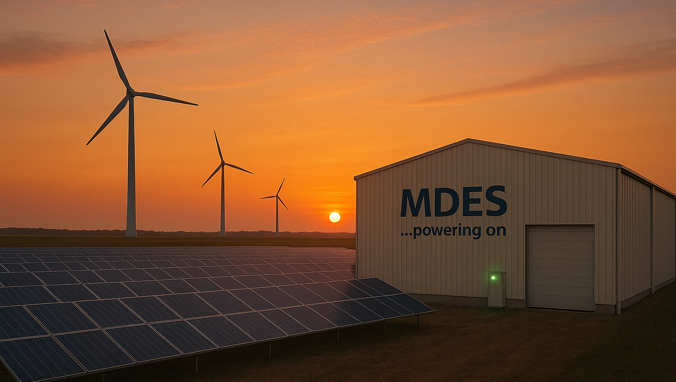




www.MDESAlliance.com
www.era.ac.uk
www.Nottingham.ac.uk
https://iea.es.org.
Medium-Duration Energy Storage:
An introduction to its importance and the obstacles faced.
A talk delivered by S. Garvey on Jan 19, 2026 at Medium Duration Energy Storage: Policy and Markets

Slide 2
Contents:
The driving requirement for flexibility and where does it come from?
How we can evaluate solutions:
Why interconnection does not obviate the need for energy storage
Why demand-side response does not obviate the need for energy storage
Why gas-fired gen does not obviate the need for storage
Why “baseload” nuclear power does not obviate the need for storage
Dividing energy storage according to timescales: VSDES, SDES, MDES, LDES
Some critical issues faced by MDES
Slide #2

Slide 3
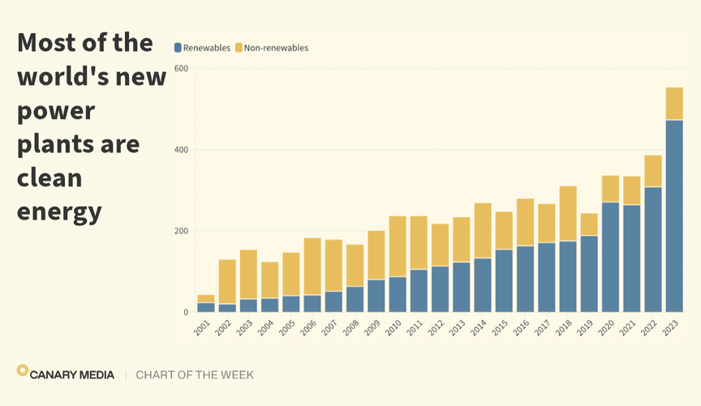
A: The driving requirement: #1
Renewable energy delivers the cheapest electricity available and is now being installed much more quickly than anything else.
Decarbonisation was originally a key motivation. Now energy independence and basic economics are driving the adoption of more renewables and decarbonisation is almost a side-benefit.
https://www.canarymedia.com/articles/clean-energy/chart-85-of-new-electricity-built-in-2023-was-clean-energy
Slide #3

Slide 4
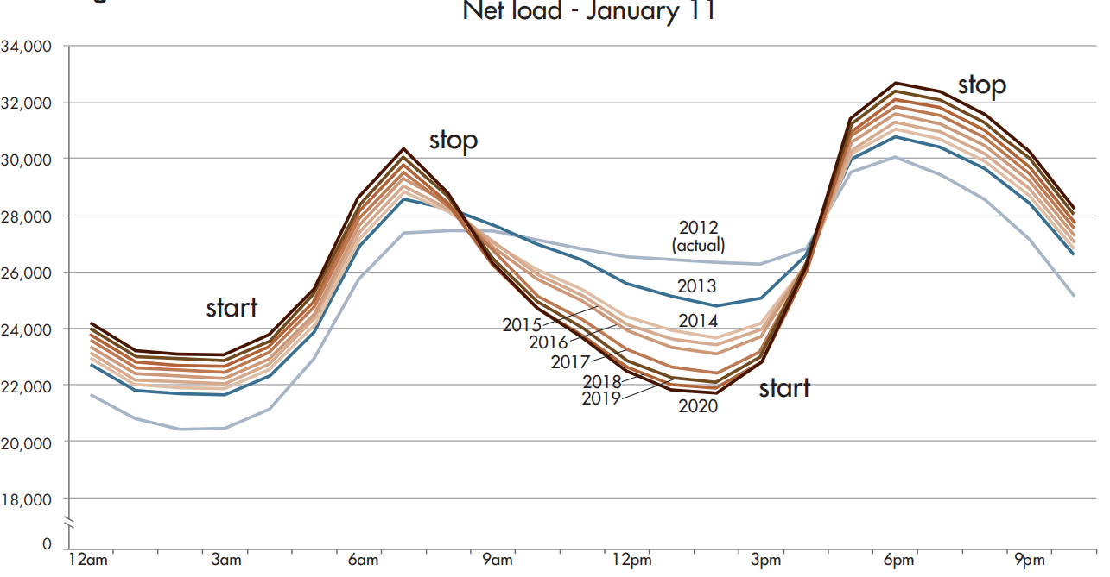
A: The driving requirement: #2
For wind and solar power (and also wave and tidal power), the resource is not always available when power is required – even with blends of renewables. This calls for the use of flexibility measures. This is dominated by variability in supply.
(For GB and Ireland anyway)
http://large.stanford.edu/courses/2015/ph240/burnett2/docs/flexible.pdf
Slide #4

Slide 5
A: The driving requirement: #3
Several different types of flexibility measure have the potential to help in reconciling the difference between supply and (natural) demand over time. The main classes are:
Energy storage – redistributing energy in time
Demand-side management (effective over short timescales, but only those)
Over-generation with deliberate turn-down (helpful, but expensive)
Interconnection – redistributing energy in space (always a 2-party “play”)
If energy storage was both inexpensive and high-performance, it would certainly be the solution of choice and nothing else would be required.
Slide #5

Slide 6
B: How we can evaluate solutions: #1
There are many different viable solutions to the one problem. The optimum will always comprise a mixture of flexibility measures. What mixture?
In principle, cost-optimal solutions can be found by parameterising all of the possibilities, applying suitable cost- and performance- models, developing a system simulation tool that can run reasonably quickly over long periods of time (several decades) and then running an optimisation problem.
The problem is too big to optimise in full: *hourly supply and demand data for decades, *exploiting some ability to forecast, *many separate “nodes”, * many different arcs(connections) between “nodes”, multiple possible flexibility assets at each node, … etc.
https://www.era.ac.uk/resources/NStore_Sim
[NStore_Sim] … written alongside 2023 R-S report is useful!
Slide #6

Slide 7
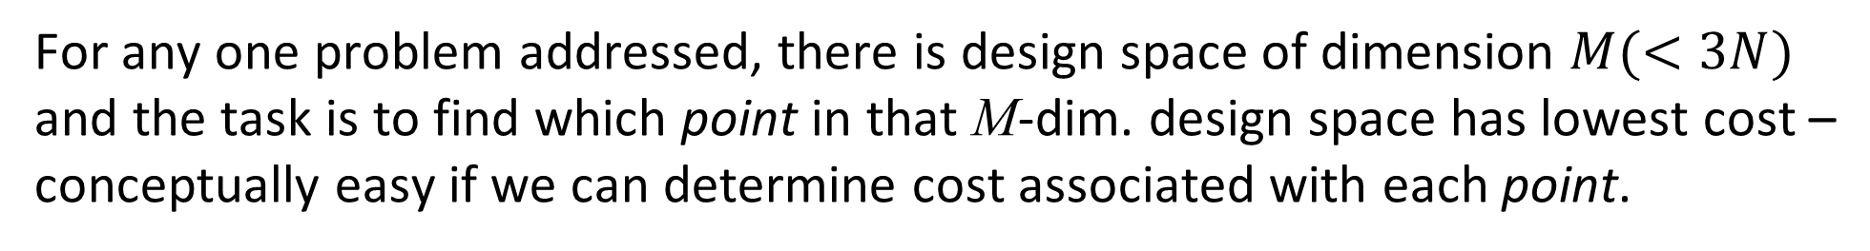
B: How we can evaluate solutions: #2
[NStore_Sim] optimises single-node energy systems comprising N different classes of energy store – each having its own costs.
[NStore_Sim] allows up to 3 different parameters for each one of the N stores: input power rating, output power rating and energy storage capacity.
For any one problem addressed, there is design space of dimension $M(<3N)$ and the task is to find which point in that M-dim. design space has lowest cost – conceptually easy if we can determine cost associated with each point.
For any one point (system design), we determine the minimum level of over-generation to make the system work and then sum the energy storage costs with the cost for generation. Generation costs always dominate!
Slide #7

Slide 8
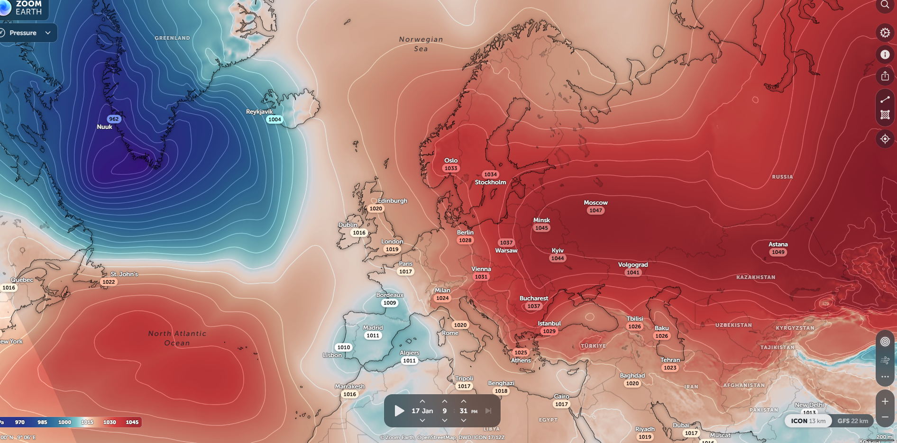
C: Interconnection: #1
The wind is always blowing somewhere - or the sun is always shining somewhere.
Interconnection can spread power over long distances. That can help ...
Interconnector | Capacity (GW) | Country
IFA | 2.0 | France
IFA2 | 1.0 | France
ElecLink | 1.0 | France
BritNed | 1.0 | Netherlands
Nemo Link | 1.0 | Belgium
NSL | 1.4 | Norway
Viking Link | 1.4 | Denmark
Moyle | 0.5 | Northern Ireland
East-West | 0.5 | Rep of Ireland
https://www.ofgem.gov.uk/press-release/empowering-great-britain-clean-and-flexible-energy-future-next-generation-interconnectors#:
~4750 km (3000 miles)
... but distances characterising weather systems span thousands of km.
https://zoom.earth/places/europe/#map=pressure/model=icon
Slide #8

Slide 9
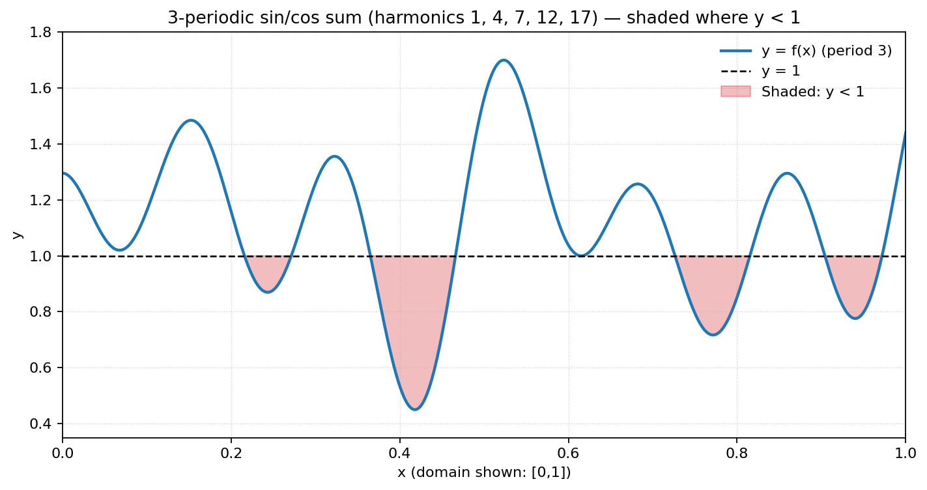
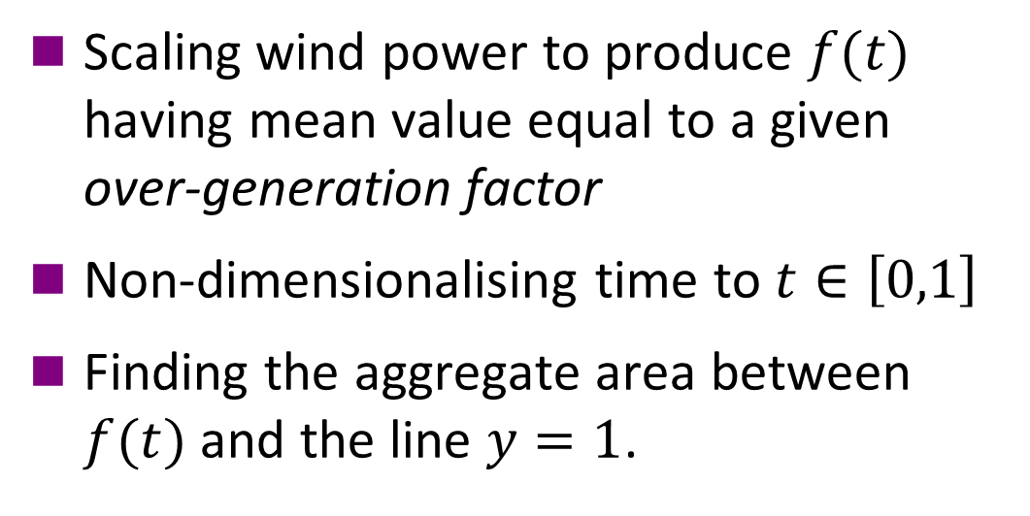
C: Interconnection: #2
We can get insight into how useful interconnection is by examining how the variability of wind resource is affected by agglomerating regions.
Variability can be measured by:
Scaling wind power to produce $f(t)$ having mean value equal to a given over-generation factor
Non-dimensionalising time to $t∈\left[0,1\right]$
Finding the aggregate area between $f(t)$ and the line $y=1$.
Illustration with over-generation factor of 1.1
Slide #9

Slide 10
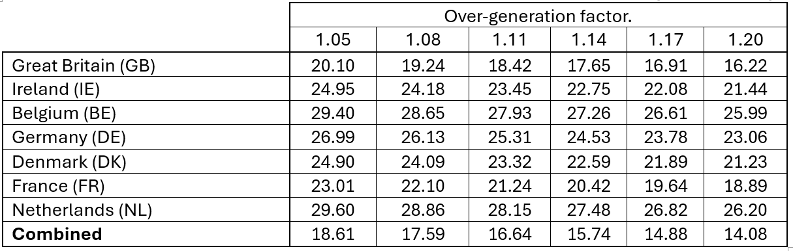
C: Interconnection: #3
I used Renewables.Ninja to obtain the capacity factor for all-country wind power for 7 of the windiest countries in Northern Europe over 45 years. I also created a linear combination of those capacity factors with coefficients proportional to the respective annual electricity consumptions.
Wind “variability” (in percent) for different levels of over-generation.
Slide #10

Slide 11
D: Demand-side response #1
Demand Side Response (DSR) has good potential to help – but mainly over short timescales because of the nature of the demands that can be flexed.
EV Charging: 20 million EVs at ~50kWh per car would be 1TWh … probably ~12 hours of average demand in 2040. The primary purpose of EV batteries is not grid support!
Electric Heat Pumps working with thermal storage¥ (Need to over-rate the heat pumps to achieve this). 12 hr limit??
Commercial refrigeration & air-con, air-compression, pre-cooked meals etc. .. all probably <12 hours of flexibility.
¥ (Especially using Phase Change Materials)
Slide #11

Slide 12
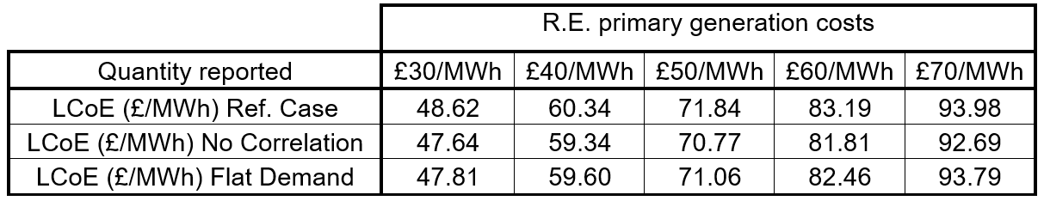
D: Demand-side response #2
Using [NStore_Sim] to design optimal energy systems indicates¥ that the shape of demand makes very little difference to overall system cost!
¥ Analysis for a paper in preparation uses 45 years of GB R.E. data and weather-correlated demand.
Slide #12

Slide 13
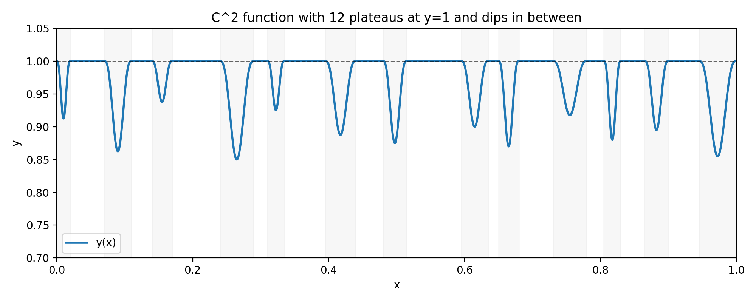
E: Gas-fired generation: #1
Gas-fired generation plays a major role presently in providing flexibility.
If wind turbines and solar panels had power-output profiles that were almost-constant output with occasional drop-offs, then gas-fired generation could be the perfect complement!
If only some combination of wind power and solar power produced output profiles like this … !
Slide #13

Slide 14
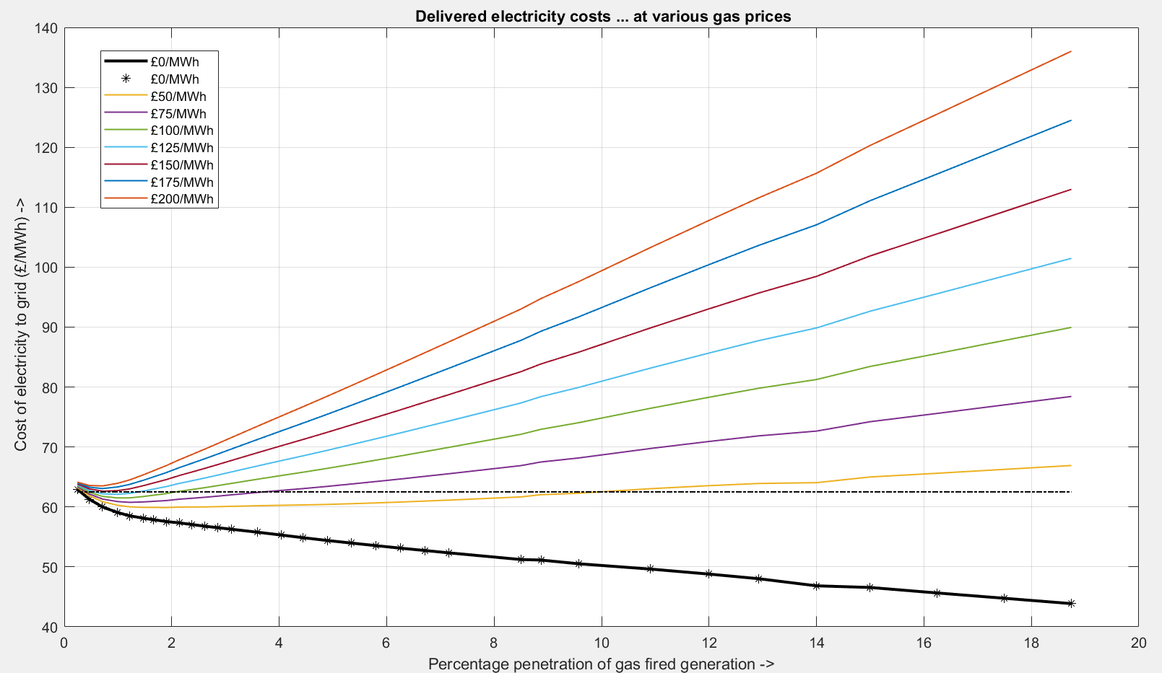
E: Gas-fired generation: #2
Treating gas-fired gen^{n}. as the source of last resort and attaching zero marginal cost to each MWh generated, illuminates the effects of including some gas-fired generation on overall system cost.
Costs of energy delivered to grid with (£40/MWh) assumed for R.E.
The penetration of gas-fired generation in a future cost-optimal GB energy system is <2% (and we can get that from bio-gas!)
Slide #14

Slide 15
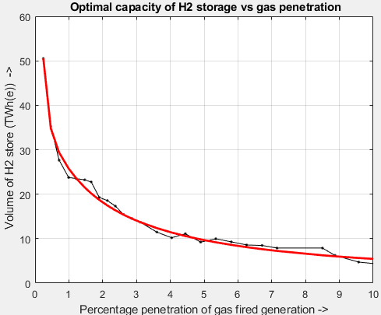
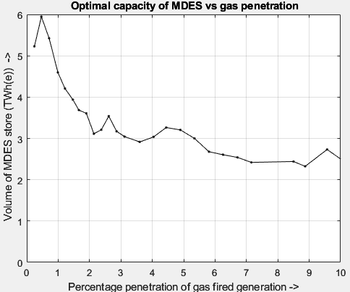
E: Gas-fired generation: #3
Presuming that we will draw significant fractions of electricity from gas-fired generation has profound effects on what would be the optimum ES capacities.
The main effect of increasing gas generation is to reduce requirements for Hydrogen (LDES).
Slide #15

Slide 16
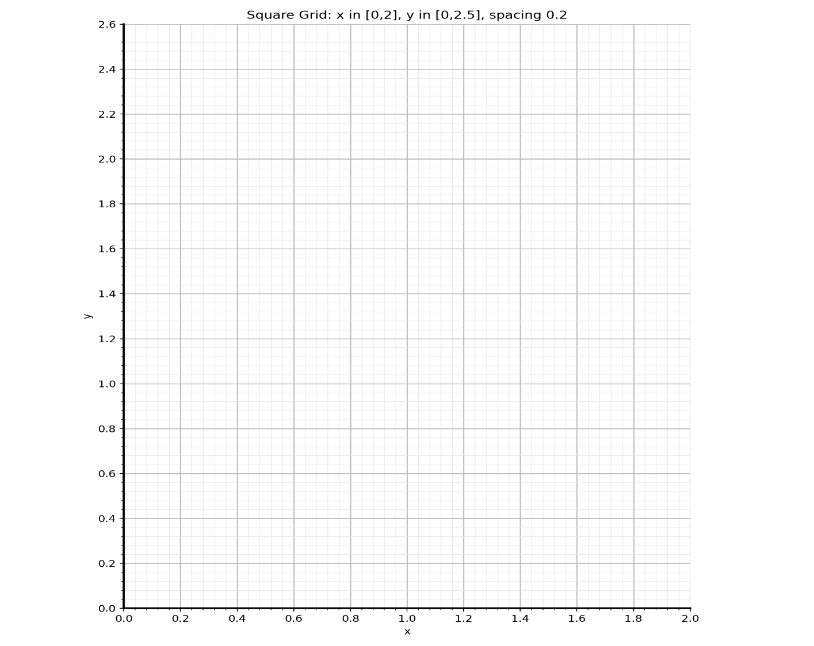
F: Nuclear-powered “baseload” #1
Nuclear power has high capital cost and very low marginal cost per MWh produced.
Commercial viability depends on operating most of the time. Subtracting constant-power nuclear from a demand profile makes residual demand proportionately more variable.
Demand becomes more variable if you subtract a constant value
Slide #16

Slide 17
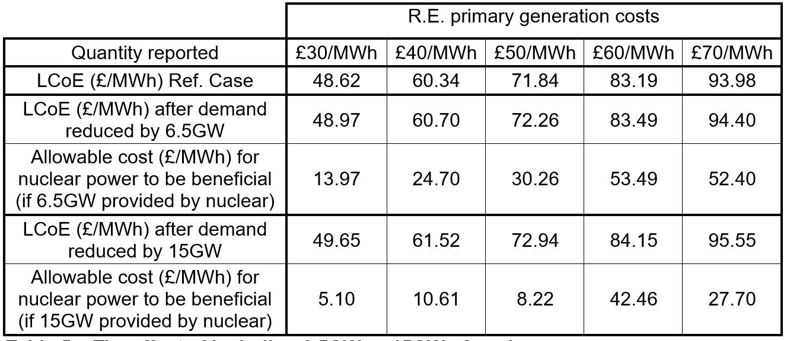
F: Nuclear-powered “baseload” #2
[NStore_Sim] was applied to optimise a (570TWh/year) GB system with: (a) no nuclear power contribution, (b) 6.5GW of nuclear power and (c) 15.0GW of nuclear power.
Nuclear power makes life harder for renewables+storage (except possibly in terms of deployability)
Slide #17

Slide 18
G: Dividing storage duties by durations: #1
Storage durations can be categorised in multiple ways, but it makes sense to focus on discharge duration.
It is proposed that there are four main attributes of energy storage systems governing what discharge durations they are suited for:
Cost per unit of energy storage capacity ($/kWh)
Cost per unit of output power ($/kW)
Cost per unit of output power slew rate ($/(kW/s))
Roundtrip efficiency.
Correspondingly, there are four main classes of discharge durations:
Slide #18

Slide 19
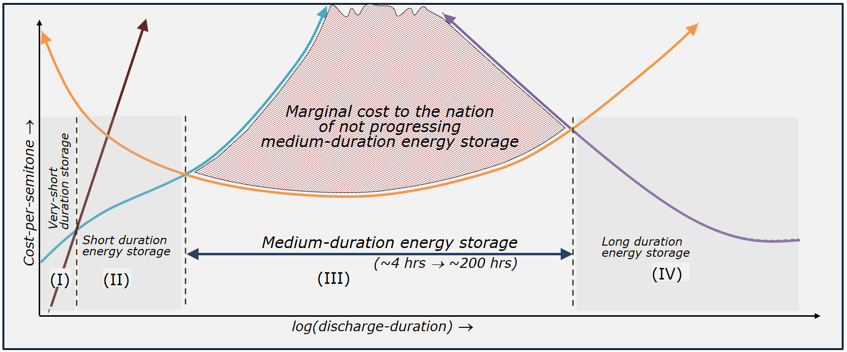
G: Dividing storage duties by durations: #2
This schematic highlights why there are 4 main classes of duration: VSDES, SDES, MDES, LDES
Slide #19

Slide 20
G: Dividing storage duties by durations: #3
Every storage technology has a band of duration times that is most favourable for its operation. So, we can discuss “MDES technologies” and “LDES technologies”.
Importantly, “LDES technologies” can provide services over all discharge ranges of discharge duration (VSDES, SDES, MDES and LDES) and would like to!
Similarly “MDES technologies” can provide services over the VSDES and SDES ranges as well as in the MDES ranges - and would like to!
Slide #20

Slide 21
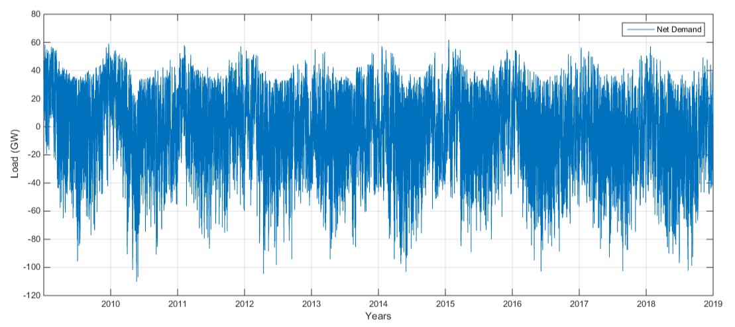
G: Dividing storage duties by durations: #4
Most (>85%) of the energy that will emerge from storage in future will be drawn out in the MDES range of discharge durations.
To appreciate this, construct a realistic profile of Net Demand (expected demand minus expected supply profile) and categorise every positive-half-cycle into three or more bins according to its length.
1hr
1hr
Bin #1
Bin #2
Bin #1
1hr
1hr
1hr
1hr
Net Demand
Slide #21

Slide 22
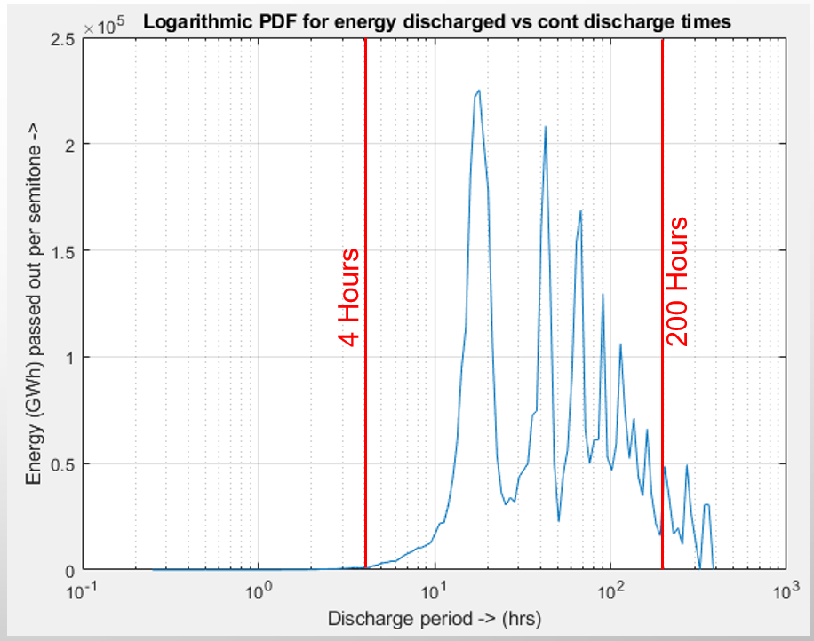
G: Dividing storage duties by durations: #5
If we use many bins, we can approximate a Probability Density Function.
This plot utilises the same data as was used in the 2023 Royal Society report entitled Large Scale Electricity Storage. With this data, >90% of energy from storage is in MDES range!
c.f. talk by B. Cardenas at MDESAlliance general meeting #1 which explained the tool process_ND.

Slide 23
H: Some critical issues: #1
Energy storage was not required at all to begin introducing renewables. This has formed an incorrect assumption/acceptance that “we mainly just need to build more solar panels and wind turbines”. Storage is not politically saleable!
Related to the above, the idea that energy costs ($/MWh) can be compared directly between wind turbines and gas-fired plant remains rooted (and the CfD mechanism in the UK is founded on that now-fallacious idea).
The entire global motivation towards decarbonisation of energy has been harmed by non-scientific “post-truth” assertions.
Slide #23

Slide 24
H: Some critical issues: #2
As requirements for energy storage begin to develop, the duties required are all over short timescales and so the SDES technologies (all batteries) have a growing commercial case that is establishing much traction and taking away a key part of the possible value stack for MDES and LDES technologies.
No one element of an energy system is essential. Not CCS, not hydrogen, not interconnection, not nuclear power, not wind power etc. etc. and not MDES. To understand the case for including any one element, we need useful energy system models that can be scrutinised. The data underpinning the development of energy policy should be open!
Slide #24

Slide 25
H: Some critical issues: #3
The MDES technologies have no separate market other than grid support. It is different for batteries (serving SDES) and for hydrogen (serving LDES). This is problematic.
Most technologies best suited to MDES duties are (thermo-)mechanical in nature:: Pumped Hydro E.S., Compressed Air E.S., Liquid Air E.S., Pumped Thermal E.S., Reversible Liquefaction of CO2 etc. etc.. All of these technologies have best performance and costs at large physical scale. This creates a high hurdle for market entry.
Similarly, all of these technologies have relatively high capital cost but very long natural lifetimes (40-70 years). Private investment markets are not geared-up for slow payback times.
Slide #25

Slide 26
H: Some critical issues: #4
To reach their full potential, MDES technologies have to invest big and hope to sell product widely across the globe. There is a “catch-22” phenomenon here for MDES; no (highly-developed) product yet ⇒ limited interest to enter into contracts ⇒ low investment confidence just at present
Some of the services provided by MDES technologies are vital to the functioning of an energy system powered mainly by renewables but these services have no associated market at present.
Slide #26

Slide 27
Thanks for listening
Seamus.Garvey@nottingham.ac.uk
Slide #27

