Slide 1

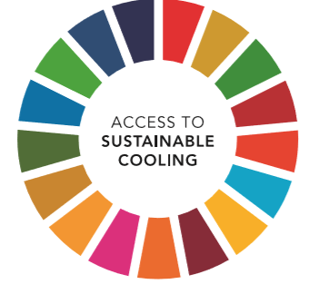
EQUITABLE ACCESS to SUSTAINABLE COOLING
Doing Cold Smarter
Toby Peters
Professor, Cold Economy, University of Birmingham

Slide 2



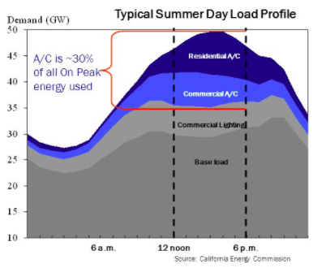
Why Cold Matters?
Artificial cooling is the backbone of our society – food, health, comfort, data.

Slide 3
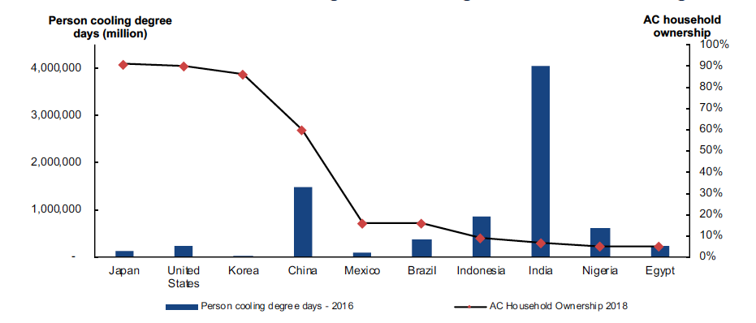
Why Cold Matters?
Asian Pacific middle class could grow six-fold to 3.2 billion in 2030
Spending power could rise from $5 trillion to $33 trillion.
built on cooling ….
Source: IEA Report: The Future of Cooling: Opportunities for Energy-efficient Air Conditioning (2018); United Nations, Department of Economic and Social Affairs Population Division (2017); https://www.degreedays.net/

Slide 4
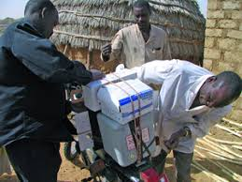
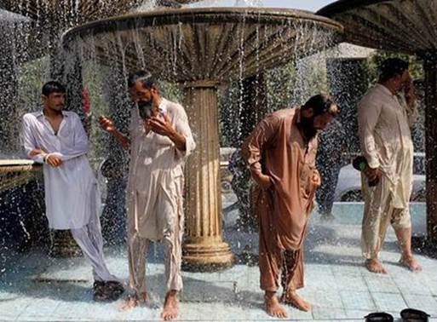
Why Cold Matters?
More than 1bn people do not have access to cooling … and suffer the consequences
Access to cooling is not a luxury. It’s about fresh food, safe medicines and protection from heat for populations in a warming world. It is vital for economic productivity, by allowing workers, farmers and students to function effectively in comfortable optimised environments.

Slide 5




SEforALL – Chilling Prospects Report
POPULATIONS IDENTIFIED IN CHILLING PROSPECTS
1.05bn
$2.50 per day
2.2bn
$10 per day
RURAL
POOR
URBAN
POOR
LOWER-MIDDLE
INCOME
MIDDLE
INCOME
Likely to be subsistence farmers without access to an intact cold chain;
may lack access to electricity and properly stored vaccines.
May have some access to electricity, but live in housing of poor quality;
may have a refrigerator, but food often spoils due to intermittent power.
May purchase an affordable thus likely inefficient air conditioner or refrigerator that raises energy consumption and GHG emissions.
May be able to afford a more efficient air conditioner or minimize its use;
may move to energy efficient housing and working environments.
Source: Chilling Prospect - Providing Sustainable Cooling for All, SEforALL, 2019

Slide 6
Blind Spot
Cooling was blind spot in energy debates
More than 75% of the Global Impact of refrigeration is from the indirect emissions – the electricity and the generation mix, primarily fossil-fuels.
Even when looking at the full Life Cycle Analysis, the manufacture and end of life are negligible.

Slide 7
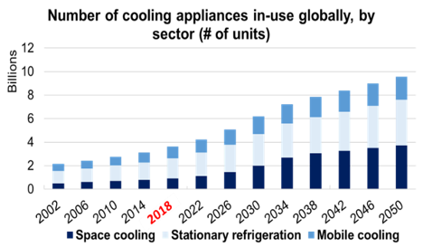
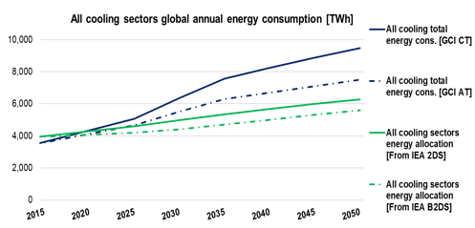
Energy Conundrum of Cooling for All
19 pieces of cooling equipment added per second for next 30 years.
Energy consumption grows to 9,500 TWh by 2050.
Exceeds IEA’s implied “energy budget” for cooling in its 2°C Scenario by more than 50%.
Projected that 80% of the RAC market will be located in developing countries by 2030.

Slide 8
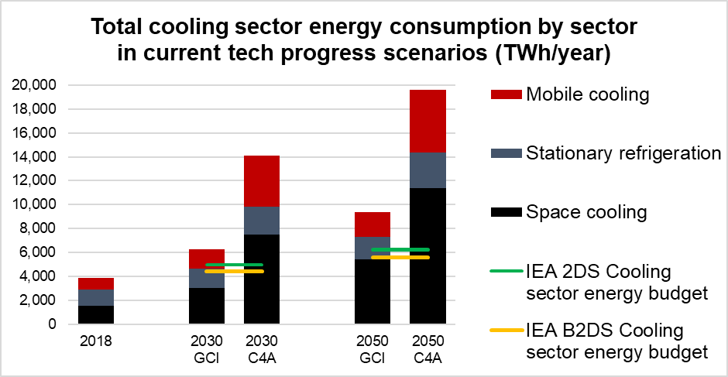
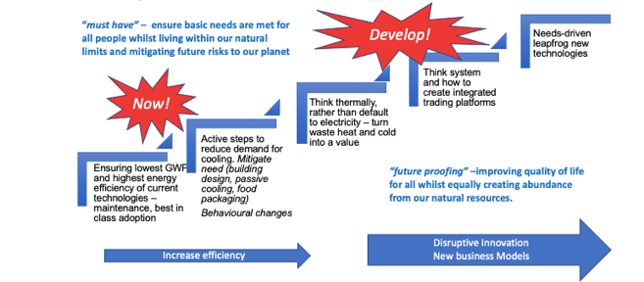
Energy Conundrum of Cooling for All
14bn appliances consuming 19,000TWh
Even with accelerated technology progress projections, energy requirement still is 15,500 TWh. (assuming maintenance)
68% - 101% of IEA % projected renewables capacity by 2050.

Slide 9
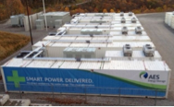
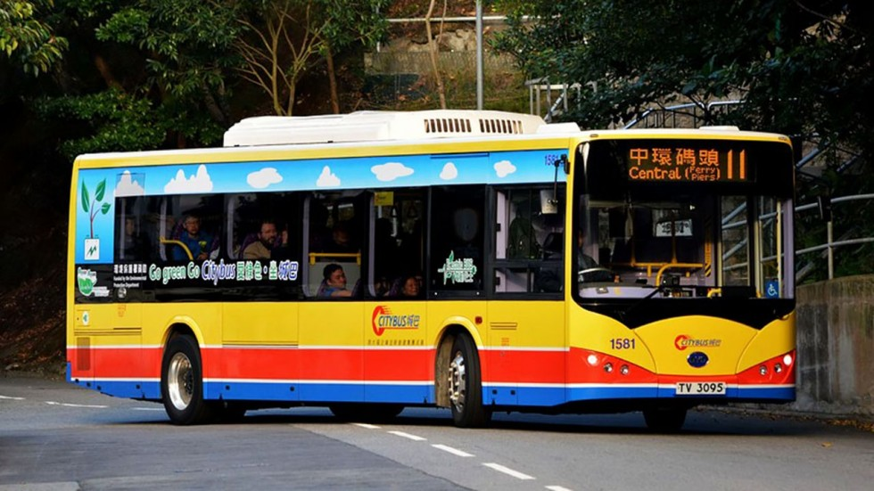
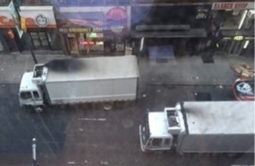

Reset Energy Strategy
The challenge is that when people talk about energy, they often mean electricity, and when they talk about energy storage, they mean batteries.
in short, we have to think thermally

Slide 10
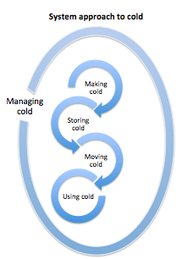
Think thermally
Planning Cold
The question is ‘what is the service we require, and backcasting how can we provide it in the least damaging way’, rather than ‘how much electricity do I need to generate?’
Financing Cold

Slide 11
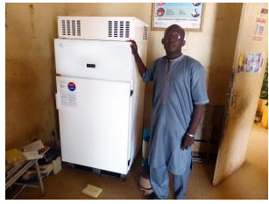
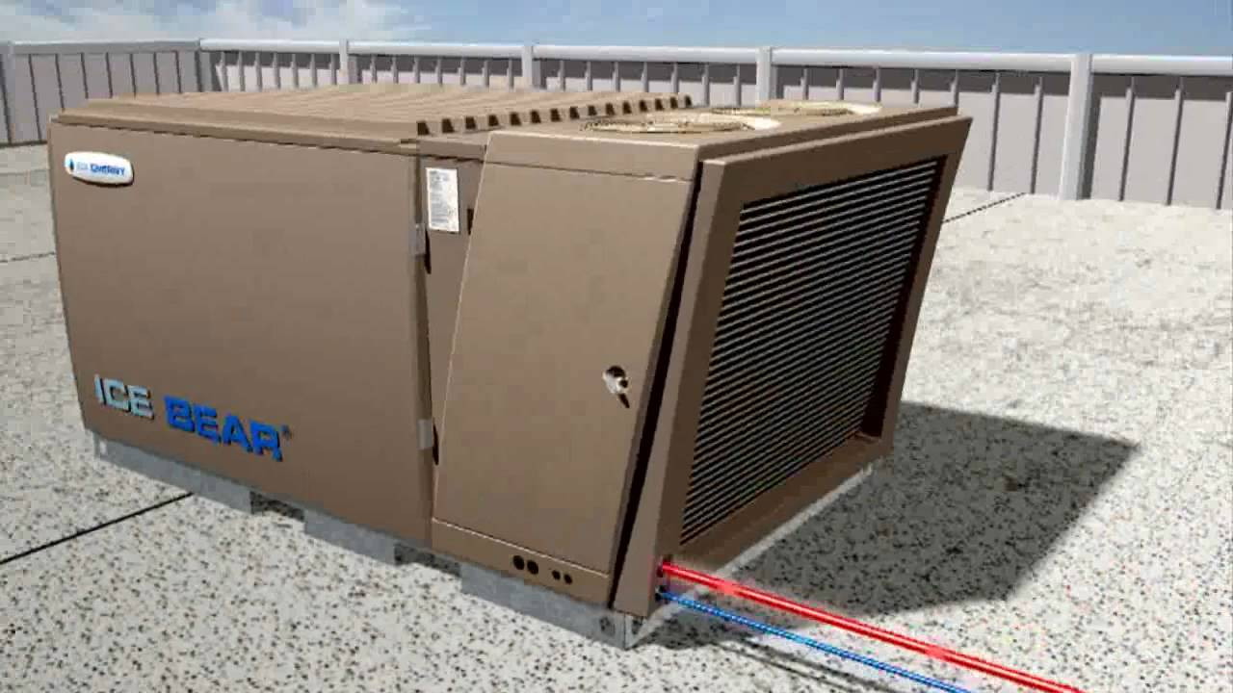
Think Thermally
Sure Chill
Ice Bear

Slide 12
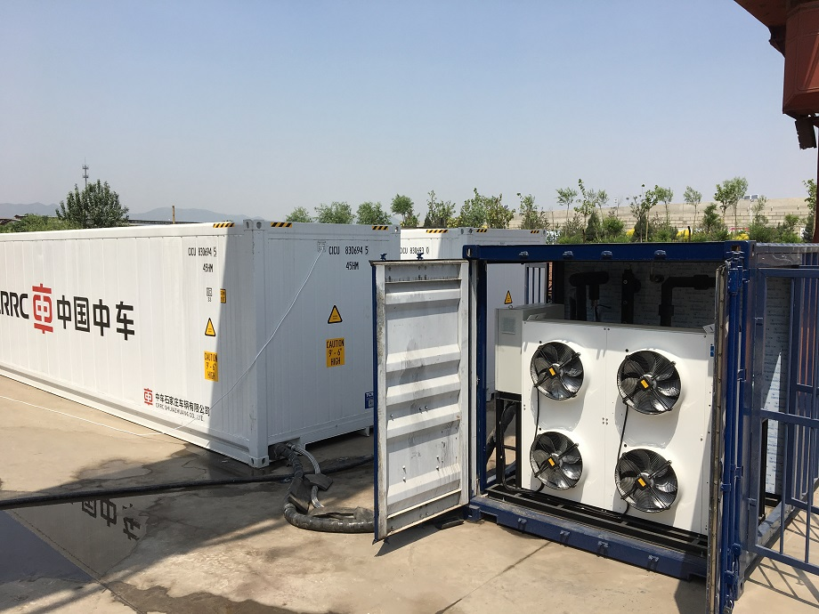
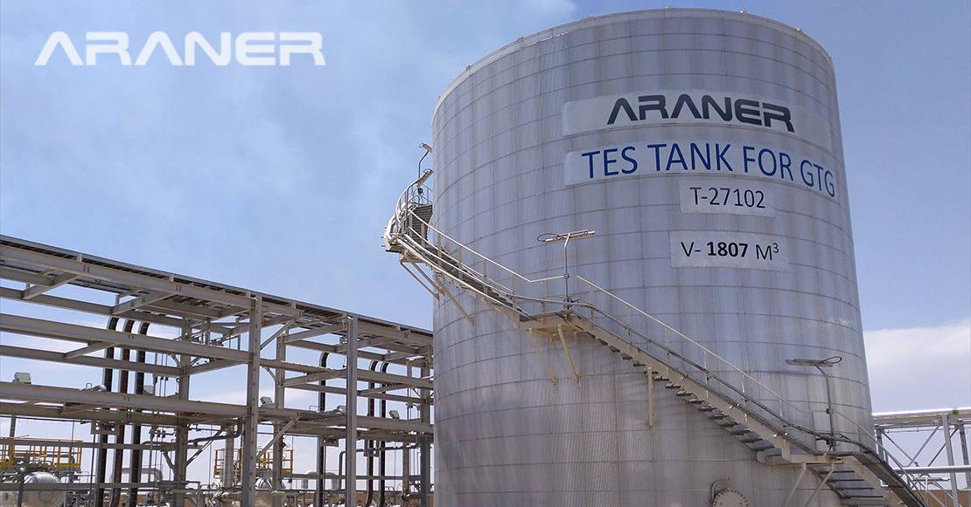
Think Thermally
Mobile Cooling
District Cooling

Slide 13
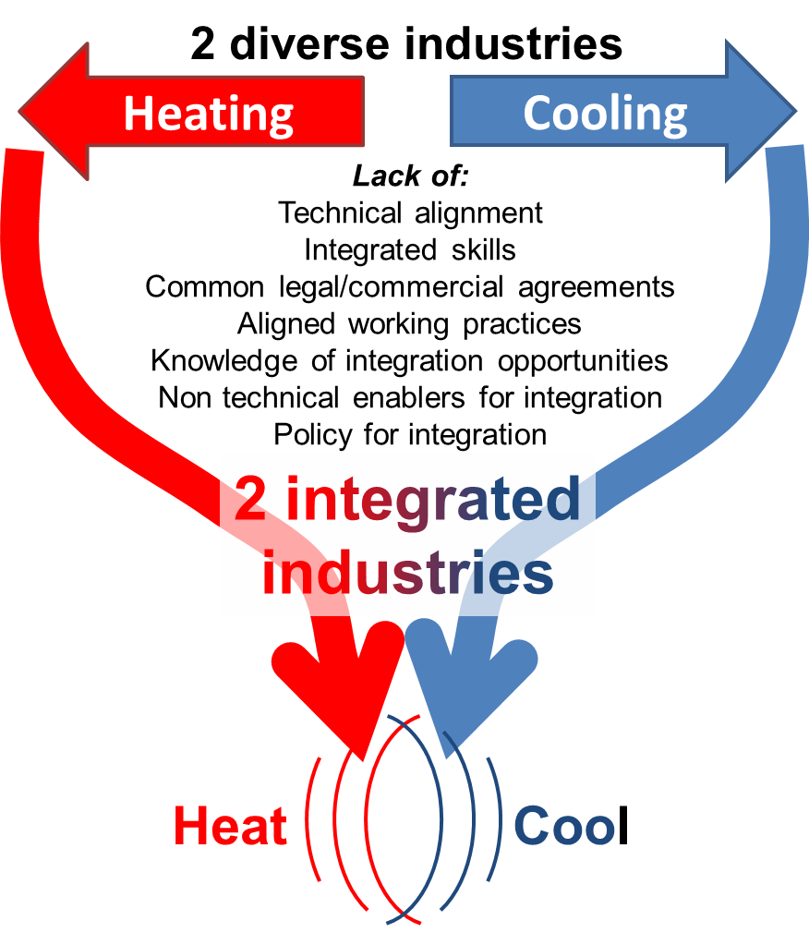
Integration
Currently in the UK there is very limited integration of heating and cooling technologies or systems, largely due to little interactions between the heating and cooling communities nor policy

Slide 14
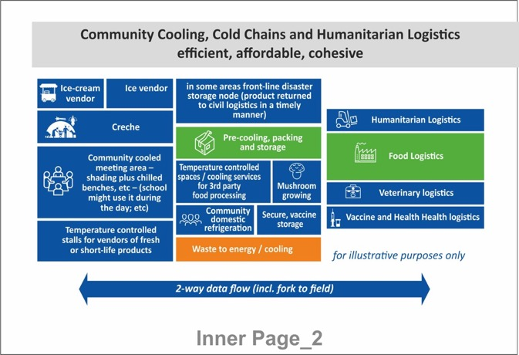
Community Cooling Hubs
Consider cold chains to store and bring fresh produce to urban markets and medicines to villages, in combination with wider community cooling need including for rural health facilities, community shelters or schools in a warming world.
Focused on all social and development goals (needs, not technology) and built on community-ownership
Does not pre-suppose a technology solution but understand the portfolio of needs and sustainable supply
Considers wider opportunities and unintended consequences of cooling
Aggregates demand to optimise system efficient energy and resource management
Stacks (bundles) revenues in business models to maximise economic opportunity
Communitarian approach bring people together rather than driving technology that cocoons to isolate
portable structres?
Peters, Kohli

Slide 15

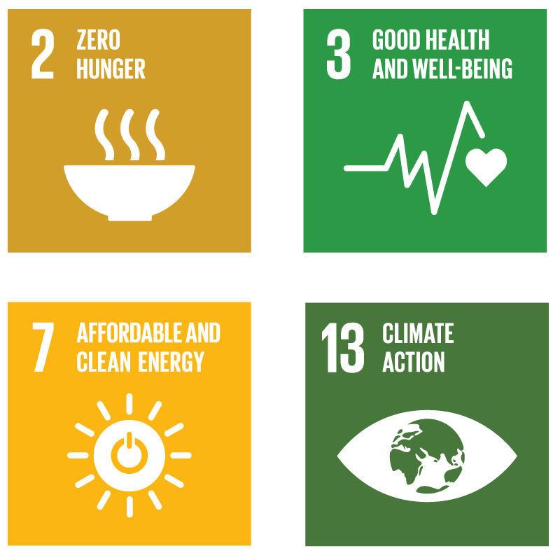



THE COOLING FOR ALL NEEDS ASSESSMENT
In order for a country, city or community to ensure that the cooling needs of their population are met, they must first understand what those needs are.
A DEEPER DIVE ACROSS 3 AREAS OF NEED
Human comfort and safety
Food, nutrition security and agriculture
Health services
INDICATORS ON HOW TO TRACK PROGRESS
Using SDGs to benchmarks progress
Establish a baseline for access to cooling
Measure the full scope of cooling demand
Understand impact of BaU
Aggregate policy, technology, and finance options
A TOOL TO:
Notes:
Food security, connectivity and rural incomes
To what extent does the population have access to the food they need to achieve a healthy (and socially acceptable) diet?
How much food is lost between farm, beach and market?
Are agricultural and fisheries incomes sufficient to keep workers out of absolute and relative poverty?
Is there missed opportunity for new or more distant market connectivity?
Thermal comfort for living, learning, working and connectivity
To what extent does the population have access to space and mobility cooling (including personal transportation) that is adequate to maintain safety and productivity, at home, in education and the work environment and while moving between each?
Health services including safe storage and transportation of vaccines and medicines
Are national vaccine programmes reaching their target population?
Is there sufficient unbroken cold-chain to ensure the provision of medicines and healthcare products?
Are health infrastructure buildings equipped with the cooling they need to deliver existing health services at affordable costs

Slide 16
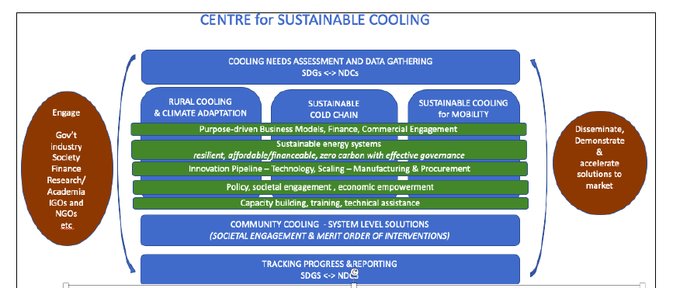
Centre for Sustainable Cooling
20+ global Research institutes working collectively
Establish the fast to market innovation pipeline, including knowledge transfer and in-country manufacture,
Socio-economically and politically relevant business and finance model innovation
Define the system of governance, policies and regulatory interventions needed to deliver on deployment strategies
Create in-market proving grounds in-country for trialling technology mixes at scale and demonstrating impact, providing a launch-pad for accelerated commercial uptake and establish a showcase for investors to have first mover advantage.
Identify future skills and training needs
Consider unintended consequences

Slide 17
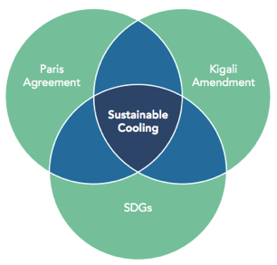
Doing Cold Smarter
“Economic and social development and the environment have to live together; you can no longer have one at the expense of the other. Rather our aim has to be a world where everyone can live well and within the sustainable limits of our planet.
Cold sits at the nexus of this challenge.”

