Slide 1
[NStore_Sim]
A suite of code enabling the user to discover the optimum storage arrangements for running a net-zero energy system.
Drawing heavily on work by …
Chris Llewellyn Smith
Stan Zachary
Tony Roulstone & Paul Cosgrove
Bruno Cardenas
Mike Muskett

Slide 2
[NStore_sim]: The problem statement
For some given single-node energy system, if we have the following information: …
A long trajectory of total electrical demand
A corresponding profile of RE generation (that we will scale)
Cost information about N different energy storage options
Knowledge of the turnaround efficiencies of each storage option
A clear criterion for what it means for the system to be acceptable
… what set of storage parameters will lead to lowest overall cost?
[NStore_sim] enables the user to answer this question approximately.
It does not find the exact lowest cost configuration but it does invariably find a good configuration with cost close to the minimum.

Slide 3
What does acceptable mean ?
[NStore_sim] supports two different (but similar) criteria for what it means for the system to be acceptable
Criterion #0: A system is acceptable if the total unmet demand over the period of interest does not exceed a certain stated threshold (<NSSm_opts.UMD>) (GWh)
Criterion #1: A system is acceptable if, at every single hour during the period of interest, the slack (additional energy that could possibly be discharged during that hour) does not fall below a certain threshold (<NSSm_opts.SLK>) (GW)
In general we will avoid setting these thresholds to 0 but they will usually be very small.

Slide 4
Knowledge required about the stores
Energy Storage systems have five main metrics:
Cost per unit¤ of rated input power (£/kW(e_{input}))
Cost per unit¤ of rated output power (£/kW(e_{output}))
Cost per unit¤ of storage capacity (volume) (£/kWh(e_{output}))
Round-trip efficiency ( )
Cost per unit of energy-fill reduction¥ (end – start) (£/MWh)
Different systems are good in different ways. No one system is ideal for all purposes. At large scales, these metrics are effectively constants. We need to know these constants ¥ for each storage type of interest
¤ These costs comprise both CapEx and OpEx components
¥ This measure is relevant only for very long-duration store types (including fossil-fuelled generation)

Slide 5
Understanding the Single Store Case.
Consider, initially, that we have just one store in the system.
Four distinct parameters determine both the system cost and whether that system will be acceptable.
Rated input power G (GW(e_{input}))
Rated output power H (GW(e_{output}))
Storage capacity (volume) V (GWh(e_{output}))
Over-generation factor* X ( )
If parameters (G, H, V) lie within reasonable bounds, then there will be some minimum value X such the system is acceptable (X = X_{min}).
* X=1.2 indicates: total quantity of electrical energy generated in the record exceeds the total quantity of electrical energy consumed by 1.2.

Slide 6
Solving the Single Store Case.
Any given single-store system is described by the 4-tuple, (G, H, V, X).
We can test whether this system will be acceptable by
Initialising the energy in store at some value such as 0.7×V
Stepping through each (1-hour?) period in the record and …
If supply exceeds demand, put (some of?) the excess into store
If demand exceeds supply, draw (some of?) the shortfall from store
Adjust the energy level in the store
There is no “scheduling” problem here and no purpose for “forecasting”
[NStore_sim] can: (i) Determine whether any one 4-tuple, (G, H, V, X), is acceptable
(ii) Determine the minimum X for which (G, H, V, X), is acceptable

Slide 7
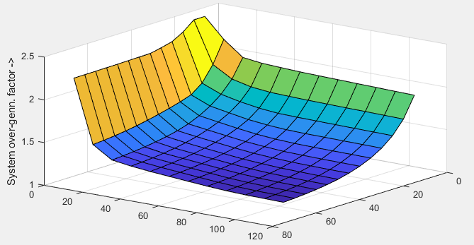
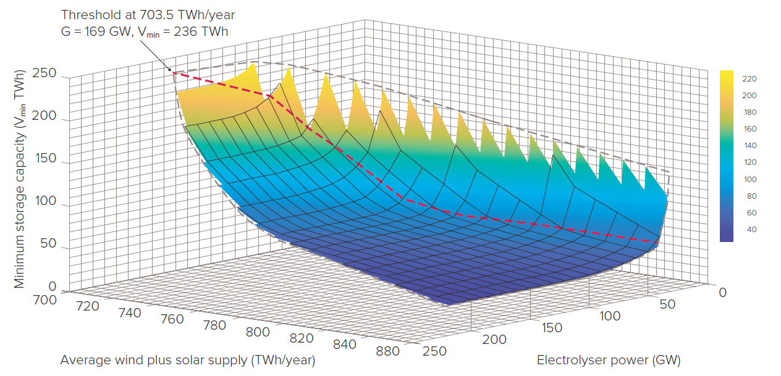
System Optimising with a Single Store
Any given single-store system could be optimised by exploring the 3D space … (G, H, V). For each “point” in this space, we calculate the associated value X_{min} as a dependent variable.
System cost is then determined from the 4-tuple (G, H, V, X_{min}).
It is straightforward to put this into an optimisation for minimum cost.
H is assumed constant here.
$$X $$
$$V \left(TWh\right) $$
$$\left(X×570\right)→$$
$$\text{} G (GW)$$
$$V (TWh)$$
From [NStore_sim] (<demo_02.m>)
From the Royal Society report

Slide 8
Understanding the case of two Stores.
Consider now that we have two stores in the system.
Seven distinct parameters determine both the system cost and whether that system will be acceptable.
Rated input powers G₁, G₂ (GW(e_{input}))
Rated output powers H₁, H₂ (GW(e_{output}))
Storage capacities (volumes) V₁, V₂ (GWh(e_{output}))
Over-generation factor* X ( )
If parameters (G₁, G₂, H₁, H₂, V₁, V₂) lie within reasonable bounds, then there will be some minimum value X for which the system behaviour is acceptable (X = X_{min}).
* X=1.2 indicates: total quantity of electrical energy generated in the record exceeds the total quantity of electrical energy consumed by 1.2.

Slide 9
Solving the two- Store Case.
Any given 2-store system is described by the 7-tuple, (G₁, G₂, H₁, H₂, V₁, V₂, X).
We can test whether this system will meet all demand by
Initialising the energy in each store #i at some value such as 0.7×V_{i}
Stepping through each (1-hour?) period in the record and …
If supply exceeds demand, spread (some of?) the excess into stores
If demand exceeds supply, draw (some of?) the shortfall from stores
Adjust the energy levels in the stores
Scheduling needed to decide which store has priority for filling/emptying
[NStore_sim] can: (i) Determine whether one 7-tuple, (G₁, G₂, H₁, H₂, V₁, V₂, X) works
(ii) Determine smallest X for which (G₁, G₂, H₁, H₂, V₁, V₂, X) works

Slide 10
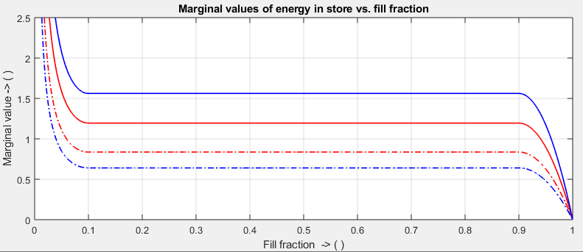
A Near-Optimal Scheduling Approach for Multiple Stores
A good scheduling approach for the operation of multiple stores in a system is described by Zachary et al. [1]
$$\left({η_{Hyd.}}^{−0.5}\right)$$
$$\left({η_{ACAES.}}^{−0.5}\right)$$
Hydrogen storage: discharging
ACAES storage: discharging
ACAES storage: charging
Hydrogen storage: charging
$$\left({η_{Hyd.}}^{0.5}\right)$$
$$\left({η_{ACAES.}}^{0.5}\right)$$
The scheduling algorithm is greedy.
Within constraints, energy is preferentially put into the stores with highest marginal value and energy is preferentially withdrawn from stores with lowest marginal value.
[1] Zachary, S. Scheduling and dimensioning of heterogeneous energy stores with application to future GB storage needs. In review. https://arxiv.org/abs/2112.00102.

Slide 11
Now for some illustrations:
Copy the entire [NStore_sim] folder from this URL …
https://drive.google.com/drive/folders/1dKNPvWl7SRgskAgVphxGjfbTio208TdH?usp=drive_link
For convenience … you can use www.TinyURL.com/NStore-sim
Start MATLAB and set the working directory to NStore_sim/scripts.
Within sub-folder <Demos>
<demo_00.m>
<demo_01.m>
<demo_02.m>
Specific optimization studies
<case_01\main_01.m>
<case_02\main_02.m>
<case_03\main_03.m>
<case_04\main_04.m>
<case_11\main_11.m>
<case_12\main_12.m>
<case_13\main_13.m>
<case_14\main_14.m>
… etc. etc.
NStore_Sim_DocC_Cases.docx … describes all of the available cases.

